Slide 1
Auction Fraud
This project was supported by Cooperative Agreement Number 2013-CK-WX-K027 awarded by the Office of Community Oriented Policing Services, U.S. Department of Justice. The opinions contained herein are those of the author(s) and do not necessarily represent the official position or policies of the U.S. Department of Justice. Reference to specific agencies, companies, products, or services should not be considered an endorsement by the author(s) or the U.S. Department of Justice. Rather, the references are illustrations to supplement discussion of the issues.
Notes:
Notes

Slide 2
Meet Zach
College student
Works part-time while going to college
Looking to purchase a laptop
Local stores didn’t have the model he wants
Starts shopping online
Notes:
Meet Zach, a 19-year-old college student who works part-time while going to school. Over the past few months Zach has picked up some extra shifts to purchase a laptop for school purposes.
Zach recently went to some local electronics store in search of a new laptop. Realizing the laptop he wanted was to not available at the local electronics stores, he took his search online to find a better deal.
We all are looking for the best deal when it comes to purchasing expensive items such as vehicles, electronics, and home appliances.

Slide 3
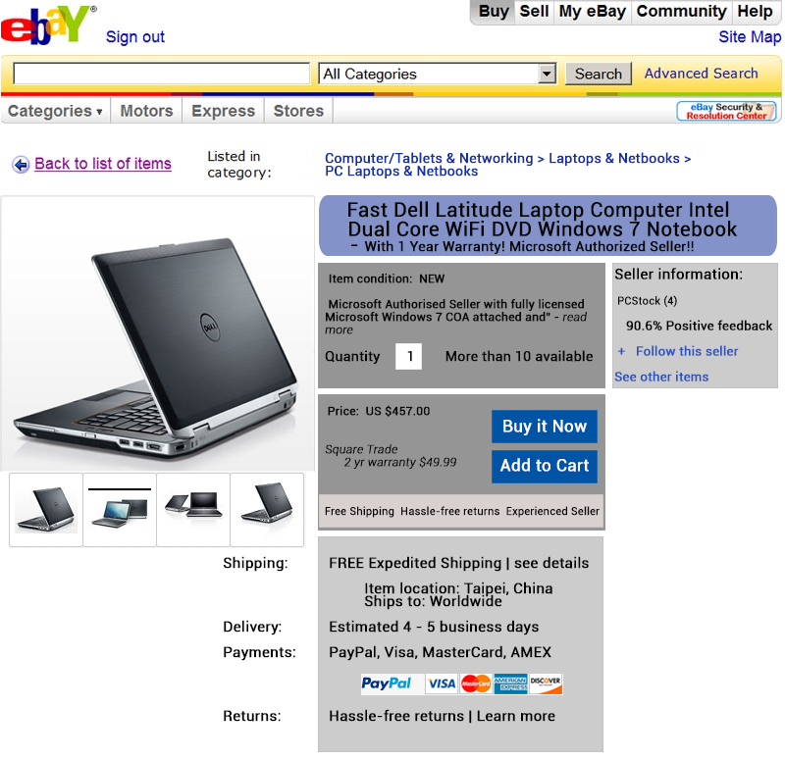
Great Deal on eBay!
Zach finds the laptop he was looking for
The laptop is $300cheaper than the normal price
Zach knows about eBay and feels safe making his purchase through their site
Zach creates an account with eBay
Notes:
After searching online, Zach finds the exact laptop he was looking for on eBay. He is familiar with eBay and feels he can get a great deal on the laptop while saving a few hundred bucks. Zach registers for an account by providing his information, first name/last name, email address and creating a password.
Common Questions: (Zach’s Questions)
How much do I want to pay? We find ourselves at auction sites because we think that the final price will be cheaper than what is offered in retail stores and online stores. We usually have an idea of how much we want to spend on something.
How long will I have to wait? The downside of purchasing online vs. purchase in retail store is the wait time for the item to arrive. Depending on the location and shipping options, we may have to pay additional fees for shipping and insurance. Not many people want to wait.
Am I obligated to pay? Winning an auction is entering an agreement to purchase an item or service. As a buyer, you are obligated to provide payment, usually within several days. If not, your privileges to buy or sell on that particular site may be revoked.
How do I find out more information from the seller? Open lines of communication are encouraged. Potential bidders and/or buyers have the opportunity to ask the seller questions prior to placing a bid just as you would in a retail store.

Slide 4
Zach Contacts the Seller
Zach writes:
Good afternoon. I am interested in the laptop you have listed. However, the model number is not listed in the description. Could you provide me with some more information? Thank you
PCStock responds:
Thank you for your interest. We have many laptops available and this model is the E1450-D. We also have different options for and additional software we can instal for you before shipping. For faster response, please provide me your e-mail or contact me at EZPC125@taipei.cn.
Zach becomes even more interested and emails the seller
as requested to inquire about additional software
Notes:
Many online auction sites allow potential bidders/buyers to utilize a messaging system to contact the seller to ask additional questions.
The eBay listing of the laptop was missing a key piece of information, but the offer seemed too good to pass up. Zach utilized the form to contact the seller to ask the question. The seller responded to Zach, not only answering his question, but to offer bonus software that was not listed in the description and to exchange email addresses.

Slide 5
Seller provides additional instructions
EZPC125@taipei.cn writes:
We have Adobo Creative Suiet for $25, EZ DVD creator for $5, and antivirus programs as additional bonuse. Also, our PayPal account is not accepting payments, however I can provide you with a 25% discount off the invoice w/ payment through Western Union. The final cost would be $357.24 with software installed. You may send payment to:
C. Wu, No. 171, Zhong Shan St., Banqiao, Taipei 560-11
Zach responds:
That sounds great! I will send payment tomorrow via Western Union.
The following day, Zach withdraws $357.24 in cash from
his account and goes to Western Union.
He completes the required form and hands the money to the cashier.
Notes:
The seller responds to Zach with prices for additional software that can be installed on the laptop. It is apparent that there are some misspellings in the email response but the offer is too good to pass up.
The seller’s Paypal account is currently not accepting payments, but the seller offers Zach an alternative means of sending payment. Western Union. Western Union is a money transfer service that enables people to wire money around the world.
Zach agrees to send the payment of $357.24 from the Western Union in his town.

Slide 6
Zach never receives his laptop
8 days have passed since sending payment
Western Union payment picked up
Original laptop listing removed from eBay
Seller does not respond to Zach’s emails
Zach files a claim with eBay
Claim was denied because there was no evidence of buyer/seller communication
Zach has no way of recovering his money
Notes:
8 days pass since Zach sent his payment via Western Union.
Zach checks his email several times a day and has not received any confirmation of shipment. Zach contacts Western Union only to learn that the money was picked up the day after he sent it. Also, since the payment was sent, the original listing has been removed from eBay, but the seller account is still active.
Zach sends several emails with inquiries about the location of the laptop, but they go unanswered.

Slide 7
What is Auction Fraud?
IC3 – Fraudulent transactions that occur in the context of an online auction site.
FTC – Internet Auction – Non-delivery or late delivery of goods that are less valuable than advertised: failure to disclose all the relevant information about the product or terms of the sale; etc.
www.ic3.gov
www.ftc.gov
Notes:
There are a number of agencies and entities that have defined Auction Fraud, but we chose to present you with the definitions used by the Internet Crime Complaint Center (IC3) and the Federal Trade Commission (FTC).

Slide 8
Subcategories of Auction Fraud
Hidden Charges
Occurs when the seller adds additional charges for postage, shipping and handling of the product. The buyer then ends up paying more than anticipated.
Fake Bidding
Occurs when the seller bids on their item in an attempt to inflate the price. This can also occur when a fake buyer submits higher bids to discourage other buyers from competing for an item; this is often referred to as bid shielding.
Notes:
A common tactic for scammers to make money is to add extra charges for postage, shipping and handling. The buyer then ends up paying more than anticipated for the item.
Fake bidding occurs when the seller bids on their own item in attempt to inflate the price.

Slide 9
Subcategories of Auction Fraud (Cont’d)
Bid Shielding
Occurs when two people work together to get the lowest price on an item up for bids. One person places a low bid while the other puts in an outrageously high bid, scaring other bidders away. In the final moments of bidding, the higher bidder will withdraw his bid, leaving the low bid as the best offer. Sellers may never know why their products sold for such a low price. Some auction sites do not allow the withdrawal of bids so that this type of scam cannot happen, eBay however does allow withdrawal for legitimate reasons.
Non-delivery
Various fraudulent online schemes induce victims to send payment for merchandise and then deliver nothing in return or an item of far less value than expected.
Notes:
Bid shielding occurs when two individuals work together in order to obtain an auctioned item for a cheap price. One bidder places a low-ball bid while another bidder places a high bid. The high bid usually discourages other potential buyers. In the final moments of bidding, the high bidder retracts their bid allowing the low-ball bid to take the item. Most sites don’t allow retraction of a bid, but eBay does under certain circumstances.

Slide 10
Auction Fraud Prevention
Could Zach have prevented
being scammed while trying to purchase a computer?
Yes
He shouldn’t have allowed the seller to convince him to communicate using email rather than the auction site messenger
He shouldn’t have made the transaction outside of the Ebay site
Notes:
Let’s go back and take a look at Zach’s situation. Is there anything he could have done to prevent being victimized? Maybe. As you can see on the screen there are a few specific things he could have done that could have prevented this from occurring.
He allowed the seller to convince him that they could communicate easier through personal email.
He could have looked for red flags
The seller was outside of the United States
The seller wanted to do the transaction outside of the auction site
The seller wanted the money sent via Western Union

Slide 11
TIPS to avoid victimization
Know your merchant
Take steps to determine the reputation of the person offering the merchandise.
Send a “test” email to see if the email address is active and try to obtain a physical address rather than merely a post office box.
Try to find a phone number for the seller and call the number to see if it is correct and working.
Research the seller by checking with the Better Business Bureau (www.us.bbb.org ), using an internet search engine, or by checking government and business websites.
Notes:
Taking steps to determine the reputation of the person offering the merchandise you are interested in prior to submitting payment is always a good idea. Most auction sites maintain some sort of rating system to advise whether the vendor is a newcomer, long time user, what type of reputation they enjoy for fair dealing, and how many complaints have been filed against them: Some auction sites even refuse to allow those with negative reputations to do business on their site. Some other methods of checking on the validity of a source include;
Send a test email to see if the email address is active.
Try to obtain a physical address rather than merely a post office box.
Try to find a phone number for the seller and call the number to see if it is correct and working.
Research the seller by checking with the Better Business Bureau (us.bbb.org), using an internet search engine, or by checking government and business websites.

Slide 12
TIPS to avoid victimization
Use a reputable auction service
Use a reputable third party escrow service, like PayPal, or at the very least, pay with a credit card to make the purchase. This way you can dispute the charge, if services are not rendered.
Protect your privacy
Never give your Social Security number or driver’s license information to a seller. (Be cautious if you are asked to supply personal information, not needed to make a purchase.
Notes:
Use a reputable auction service: When ordering online, use a reputable third party escrow service, like PayPal, or at the very least, pay with a credit card to make the purchase. This way you can dispute the charge, if services are not rendered.
Protect your privacy: When purchasing goods through an online auction site, never give your Social Security number or driver’s license information to a seller. Be cautious if you are asked to supply personal information not needed to make a purchase.

Slide 13
TIPS to avoid victimization
Understand that wiring money is like sending cash
Scammers often insist that people wire money, especially overseas, because it’s nearly impossible to reverse the transaction or trace the money. If you choose to do business in this manner, be prepared for the worst.
If you are the seller:
To avoid being totally cheated out of the potential revenue for an item being offered for sale, a good practice might be to place a “limit” price on the item offered, or a price below which you will not sell the merchandise. At least this way, you can be assured that the limit will have to be reached for the item to sell.
Notes:
Understand that wiring money is like sending cash: Scammers often insist that people wire money, especially overseas, because it’s nearly impossible to reverse the transaction or trace the money. If you choose to do business in this manner, be prepared for the worst.

Slide 14
How to report auction fraud
File a complaint with the online auction site.
Report the incident to your local law enforcement agency.
File a complaint with Internet Crime Complaint center @ www.ic3.gov.
Notes:
This slide covers what you should do if you have been a victim of auction fraud.

Slide 15
QUESTIONS
Photo Credits: “94686637 Copyright fotographic 1980, 2015 Used under license from Shutterstock.com“, “214296676 Copyright master_art, 2015 Used under license from Shutterstock.com“, "158080031 Copyright NicoElNino, 2015 Used under license from Shutterstock.com“, "138594755 Copyright JMiks, 2015 Used under license from Shutterstock.com“, "230647237 Copyright guteksk7, 2015 Used under license from Shutterstock.com“, " 238272631 Copyright guteksk7, 2015 Used under license from Shutterstock.com“, "222011950 Copyright Aleksandra Gigowska, 2015 Used under license from Shutterstock.com“, "256026160 Copyright guteksk7, 2015 Used under license from Shutterstock.com“, "147183470 Copyright LDprod, 2015 Used under license from Shutterstock.com““153213146 Copyright garriphoto, 2015 Used under license from Shutterstock.com“
Notes:
**Instructor Note: Ask the participants if they have any questions about Auction Fraud, prevention tips, or how to report this type of fraud.**

